Slide 1
NatureServe’s Benchmark Data Content Standards
Max Tarjan

Slide 2
This report was produced using data content from the January 2022 snapshot of Central Biotics.

Slide 3
A. All element global records should have:

Slide 4
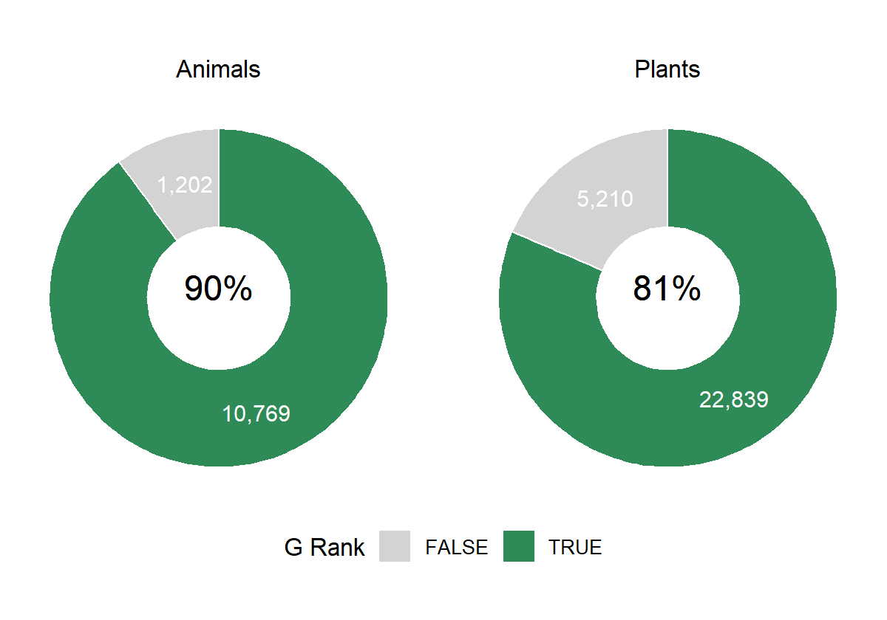
1. A global conservation status assessment.
Figure 1 . Percent of plants and animals in the primary global dataset with a global conservation status (G-rank or T-rank other than GNR/TNR).

